Slide 1


Slide 2
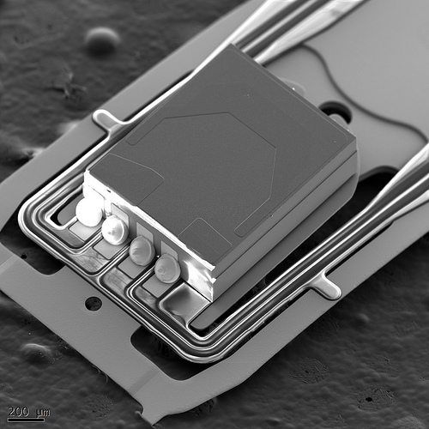
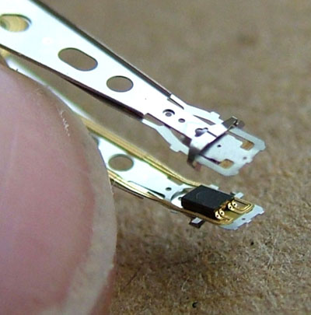
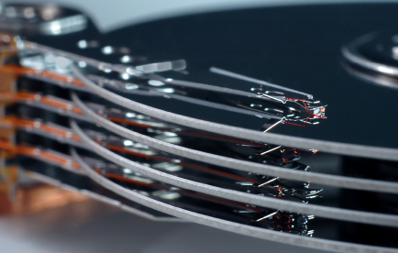
No wonder a head crash is so damaging

Slide 3
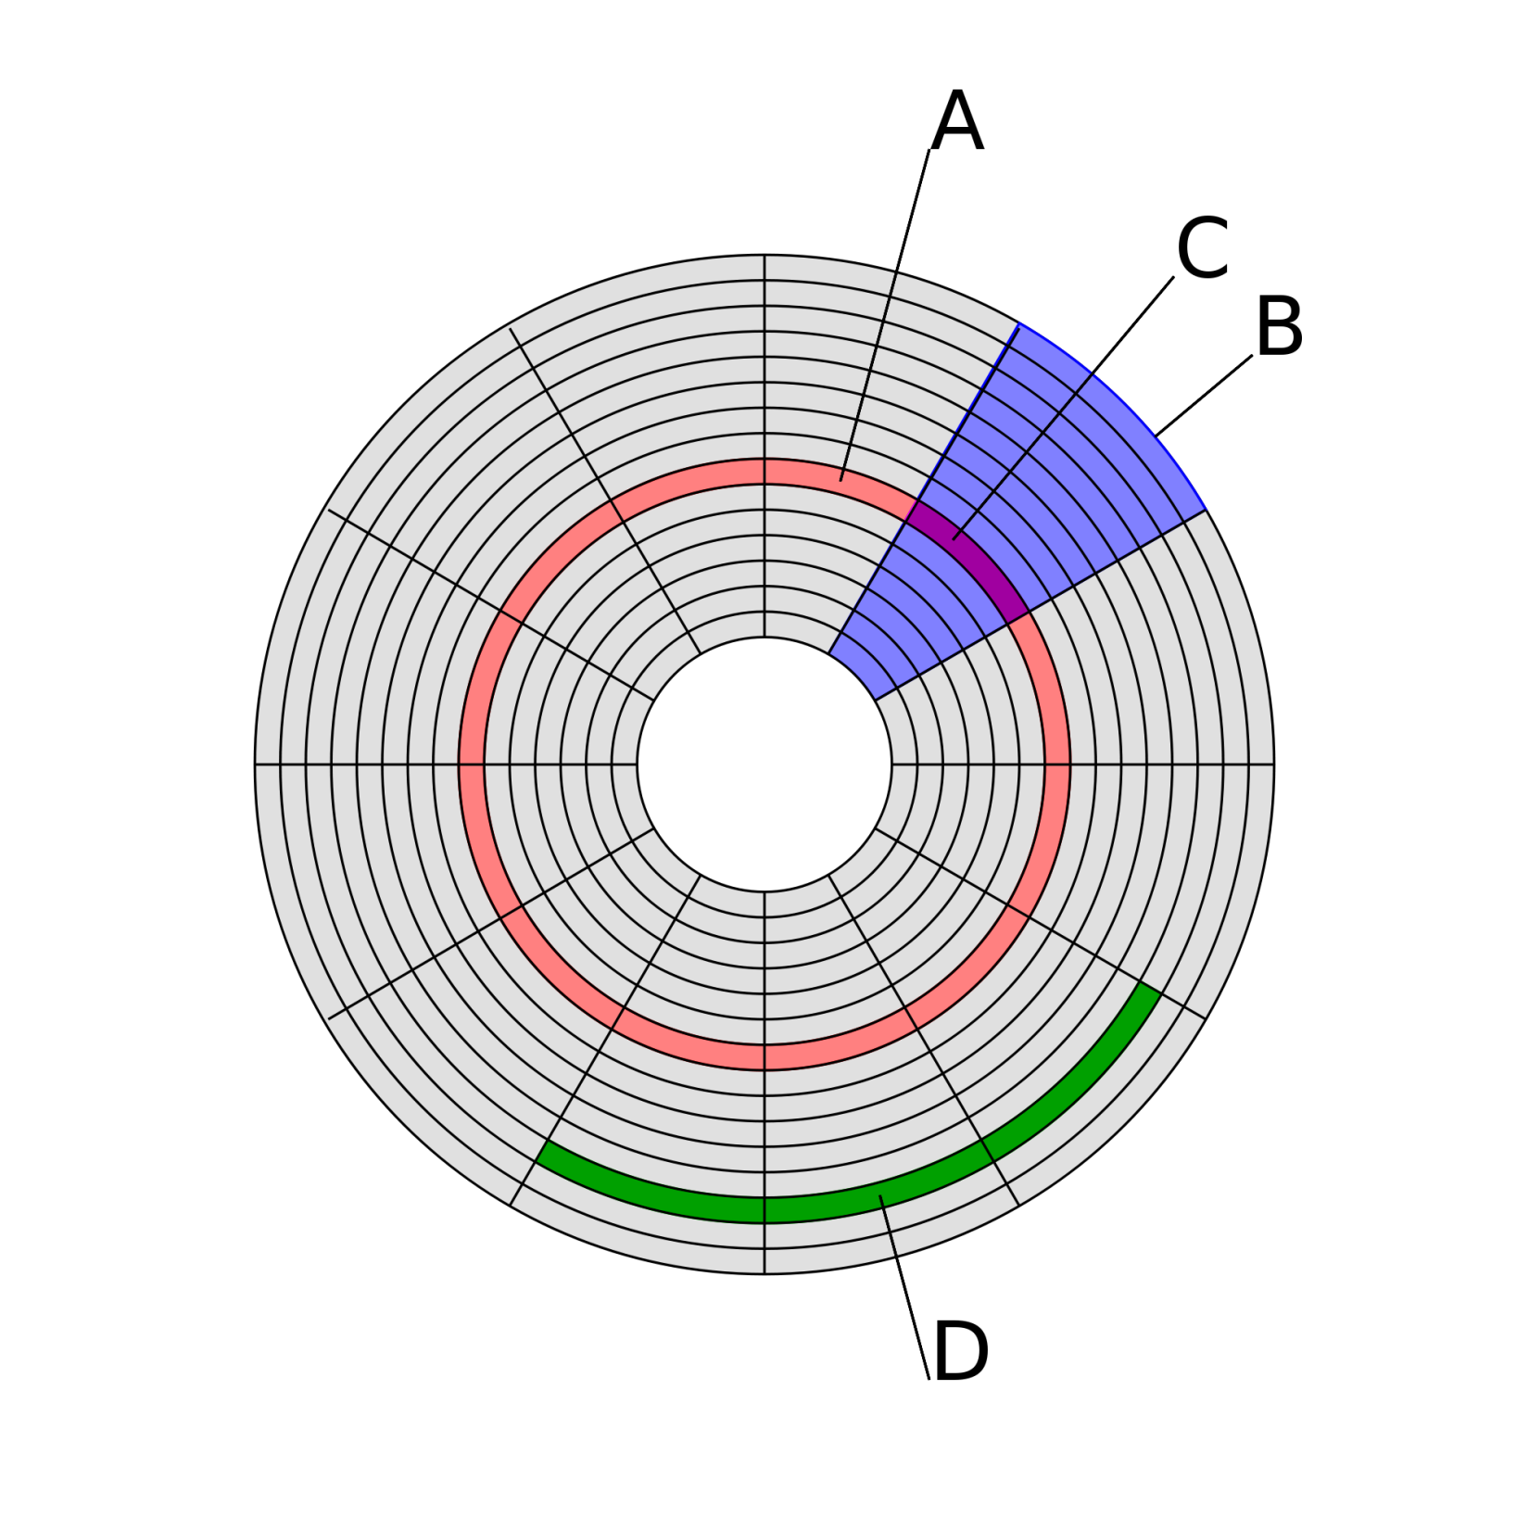
Disk structure:
(A) track
(B) geometrical sector
(C) track sector
(D) cluster

